Slide 1
100 Days of Summer Safety Campaign

Slide 2
Campaign Overview
Day 0
Purpose: To raise awareness and promote safe practices during the high-risk summer months.
Duration: Memorial Day through Labor Day (X-Y)
Key Focus Areas: Heat safety, hydration, first aid, outdoor activities, fall protection, hearing conservation, respiratory hazards, and more.

Slide 3
Week 1 – Heat Safety Basics
Understanding the risks of heat-related illnesses and how to prevent them.
Key Tips:
- Recognize signs of heat exhaustion and heat stroke.
- Wear lightweight, light-colored clothing.
- Take frequent breaks in shaded or air-conditioned areas.

Slide 4
Week 2 – Hydration Tips
Maintaining proper hydration to ensure safety and performance.
Key Tips:
- Drink water regularly, even if not thirsty.
- Avoid excessive caffeine and alcohol.
- Monitor urine color as an indicator of hydration.

Slide 5
Week 3 – First Aid Essentials
Basic first aid knowledge for common summer injuries.
Key Tips:
- Learn to treat cuts, burns, and insect bites.
- Keep a well-stocked first aid kit accessible.
- Know emergency contact numbers.

Slide 6
Week 4 – Outdoor Safety Tips
Staying safe during outdoor activities like hiking, biking, and camping.
Key Tips:
- Use appropriate protective gear.
- Be aware of weather conditions.
- Inform someone of your plans and expected return.

Slide 7
Week 5 – Fall Protection
Preventing injuries from falls during work and recreational activities.
Key Tips:
- Use Engineering Controls when ever possible and other fall protection equipment when engineering controls aren’t avaialble.
- Inspect ladders and scaffolding before use.
- Maintain three points of contact when climbing.

Slide 8
Week 6 – Hearing Conservation
Protecting your hearing in noisy environments.
Key Tips:
- Wear earplugs or earmuffs in loud areas.
- Limit exposure time to high noise levels.
- Undergo regular hearing checks.

Slide 9
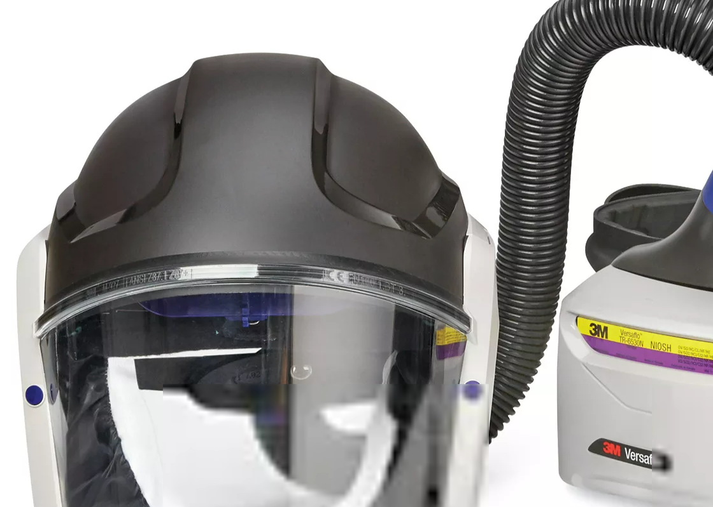
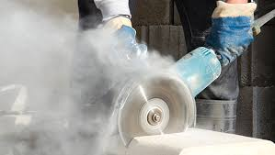
Week 7 – Respiratory Hazard Awareness
Understanding and mitigating risks from respirable crystalline silica and other airborne hazards.
Key Tips:
- Use appropriate respiratory protection.
- Implement dust control measures.
- Follow OSHA guidelines for exposure limits.

Slide 10
Week 8 – Sun Protection
Preventing sunburn and long-term skin damage.
Key Tips:
- Apply broad-spectrum sunscreen with at least SPF 30.
- Wear hats and UV-protective clothing.
- Seek shade during peak sun hours (10 a.m. to 4 p.m.).

Slide 11

Week 9 – Safe Driving Practices
Ensuring safety on the road during increased summer travel.
Key Tips:
- Avoid distractions like texting while driving.
- Never drive under the influence of alcohol or drugs.
- Follow speed limits and traffic laws.

Slide 12

Week 10 – Working Around Water Safely y
Staying safe while swimming, boating, or engaging in other water activities.
Key Tips:
- Always supervise children near water.
- Wear life jackets when boating.
- Avoid swimming alone or in unfamiliar areas.

Slide 13
Week 11 – Insect Bite Prevention
Protecting against insect-borne illnesses.
Key Tips:
- Use insect repellent containing DEET or picaridin.
- Wear long sleeves and pants in wooded areas.
- Check for ticks after outdoor activities.

Slide 14
Week 12 – Fire Safety
Preventing fires hot work activity
Key Tips:
- Keep Flammable Materials Covered when Flames are near
- Have a fire extinguisher or water source nearby.
- Follow local regulations regarding open flames.

Slide 15
Week 13 – Mental Health and Well-being
Maintaining mental health during the summer months.
Key Tips:
- Stay connected with friends and family.
- Engage in regular physical activity.
- Seek professional help if feeling overwhelmed.

Slide 16
Week 14 – Emergency Preparedness / Control of Hazardous Energy
Being
Being ready for emergencies such as storms or accidents.
Key
Key Tips:
Have
- Have an emergency plan and kit prepared.
Stay
- Stay informed with weather alerts.
Know
- Know your evacuation routes.

Slide 17
Conclusion Day 100
Review Incidents and Injuries over the last 100 Days

